Slide 1

WELCOME

Slide 2

MY MODEL NAME :-
“Student Grade Analysis And Predictions”
My Name:-khairnar Harshada Vitthal
Assisted By:-Ashwini Kakde Mam
Batch Code:-FST 2.0 ML9

Slide 3

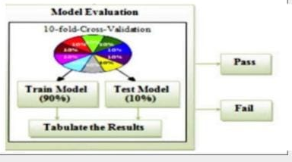
Project Objectives:-
Predictins of the final grade of the students.
To analyze the performance of students their marks and all activities performed by them.

Slide 4

Why do you choose this project?
The use of machine learning with the extraction of educational information improves the learning process of student. Various models can be developed to estimate a student’s grade in registered courses. Which will provide valuable information to make it easier for students to stay in those courses.
By accurately predicting a student's grade, this approach can be used to identify students who are at risk of failing a course or subject, and provide interventions and support to help them succeed.

Slide 5

Why is predicting student performance important?
Predicting students' performance during their years of academic study has been investigated tremendously. It offers important insights that can help and guide institutions to make timely decisions and changes leading to better student outcome achievements.

Slide 6

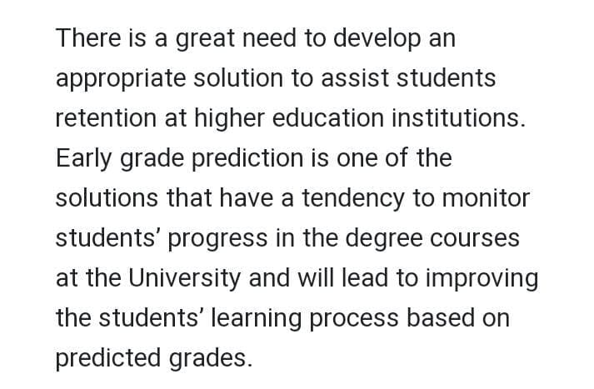
Need of the model:-

Slide 7

Project analysis:-
The data includes academic and personal characteristics of the students as well as final grade .that task is to predict the final grade from the students informations

Slide 8

Reference:
Linear Regression
SVR
K fold cross validation

Slide 9

Dataset taken from:
Kaggle

Slide 10
Use Libraries:-
NUMPY
PANDA
MATPLOTLIB
SEABORN

Slide 11
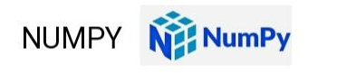
Numpy is a python library used for working with arrays.
it also has functions for working in domain of linear algebra .
It is created in 2005 by TRAVIS OLIPHANT .
It is an open source project and wr can used it freely.

Slide 12
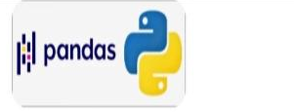
PANDAS
Allow us to analysis big data and make conclusion based on statistical theories . Panda can clean messy data sets and make them readable relevant . Relevant is very important in data science .

Slide 13
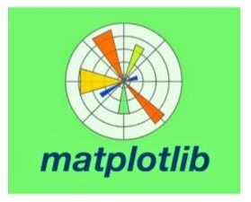
MATPLOTLIB:-
MATPLOTLIB is a plotting library for the python programming language and its numerical mathematical extensions.

Slide 14
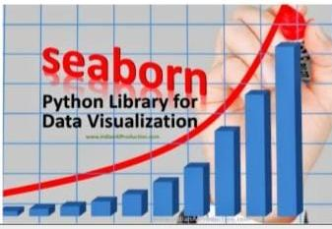
SEABORN
SEABORN is library for making statistical graphical in python.
In builds on top of matplotlib and integrates classy with pandas data structure.

Slide 15

ATTRIBUTE INFORMATION:
school - student's school (binary: 'GP' - Gabriel Pereira or 'MS' - Mousinho da Silveira)
sex - student's sex (binary: 'F' - female or 'M' - male)
age - student's age (numeric: from 15 to 22)
address - student's home address type (binary: 'U' - urban or 'R' - rural)
famsize - family size (binary: 'LE3' - less or equal to 3 or 'GT3' - greater than 3)
Pstatus - parent's cohabitation status (binary: 'T' - living together or 'A' - apart)
Medu - mother's education (numeric: 0 - none, 1 - primary education (4th grade), 2 - “ 5th to 9th grade, 3 - “ secondary education or 4 - “ higher education)
Fedu - father's education (numeric: 0 - none, 1 - primary education (4th grade), 2 - “ 5th to 9th grade, 3 - “ secondary education or 4 - “ higher education)
Mjob - mother's job (nominal: 'teacher', 'health' care related, civil 'services' (e.g. administrative or police), 'at_home' or 'other’)
Fjob-father’s job

Slide 16
famrel - quality of family relationships (numeric: from 1 - very bad to 5 - excellent)
freetime - free time after school (numeric: from 1 - very low to 5 - very high)
goout - going out with friends (numeric: from 1 - very low to 5 - very high)
Dalc - workday alcohol consumption (numeric: from 1 - very low to 5 - very high)
Walc - weekend alcohol consumption (numeric: from 1 - very low to 5 - very high)
health - current health status (numeric: from 1 - very bad to 5 - very good)
absences - number of school absences (numeric: from 0 to 93)

Slide 17


